Slide 1
AWS 2020-01 GROUP 1
mentors:
1) Lê minh nhựt
2) Ngô ngọc minh quân
3) Ngô hoàng long hải
MEMBERS:
1) nguyễn quang linh
2) Phạm văn thuần
3) Nguyễn văn hoài
4) Trần ngọc tân

Slide 2
Tomato Delivery System
Function
1) Request ship
2) Pick shipper
3) Pick item
4) Ship to customer

Slide 3
Tomato Delivery System
User react to system
Shipper
1) SHOP OWNER
3) Pick item
4) Ship item
- Request ship
2) Pick shipper
2) SYSTEM
- Pick shipper
Shop owner
TOMATO SYSTEM
Customer
3) SHIPPER
1) Request ship
5) Request
re-delivery
- Pick item
- Ship to customer
4) CUSTOMER
- Request re-delivery

Slide 4
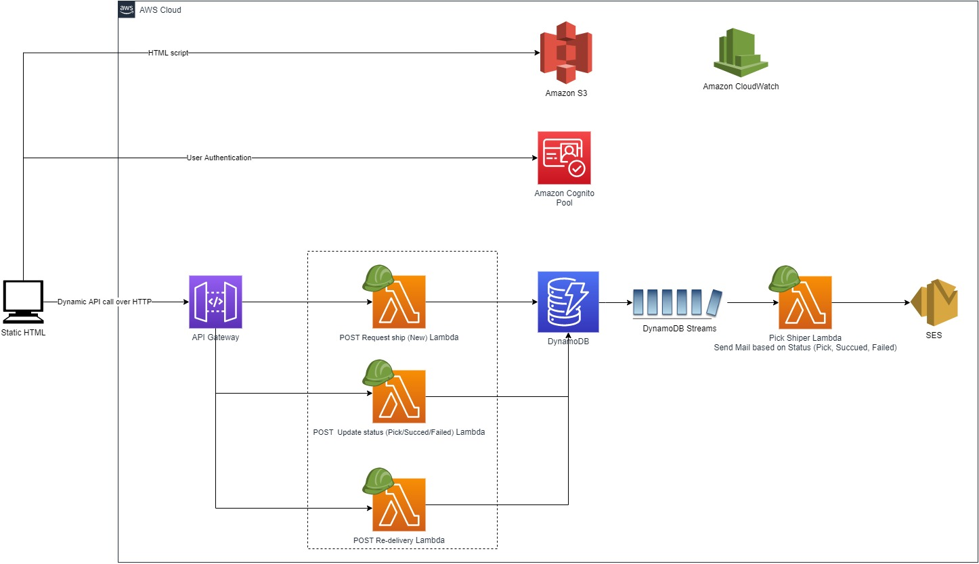
System Architecture

Slide 5
Tomato Delivery System
Member Task
- TânTN: Create html pages，Insert data from Lambda to DynamoDB
- LinhNQ2: Post data from html to Lambda, receive response from Lambda, config API gateway
- HoàiNV: Create DynamoDB, login with Cognito, get data from DynamoDB, create log metric CloudWatch
- ThuầnPV3: Create trigger DynamoDB, send mail from Lambda to SES

Slide 6
Tomato Delivery System
Demo

Slide 7
Tomato Delivery System
Q&A

Slide 8
Thank you so much!!
☺

